Slide 1
The Role Of Algorithms In Programming
Session 01
Nikita Ananda Putri Masaling, S.Kom., M.Kom.

Slide 2
Course description
Session 1
The course (COMP6049 – Algorithm Design and Analysis) describes fundamental concept of design and analysis of algorithms in order to calculate time and space computation, complexity, and compare design algorithm methods. It gives the students knowledge of several algorithm that enable students for designing a good algorithm.

Slide 3
Learning Outcomes
ALGORITHM DESIGN & ANALYSIS
By the end of this course, students will be able to:
LO 1: Evaluate the time and space complexity of algorithms using asymptotic notation and formal analysis methods, and prove algorithm correctness using loop invariants, induction, or exchange arguments.
LO 2: Analyze unfamiliar computational problems by identifying their structural properties, classifying them into known algorithmic categories including graph, string, and combinatorial problems and recommending a solution strategy with justification.
LO 3: Design solutions to unfamiliar computational problems by selecting and applying appropriate strategies including Divide and Conquer, Greedy, Dynamic Programming, and Backtracking.
LO 4: Assess the computational complexity of problems by distinguishing tractable from intractable cases, verify NP membership through polynomial-time verification, and recognize NP-hardness by mapping problem structure to known NP-complete instances.

Slide 4
evaluation
Session 1
Assignment (Individual Assignment) : 20%
Assurance of Learning (AoL) : 20%
Mid Exam : 30%
Final Exam : 30%
For AoL, students have to participate in INC (Indonesia National Contest)

Slide 5
Indonesia national contest
Inc
Indonesia National Contest (INC) is programming contest for students from universities in Indonesia. INC is preparation contest to participate in International Collegiate Programming Contest (ICPC).
Every 3rd semester students majoring computer science BINUS University MUST participate in this contest (INC). Participant in this contest will get assignment score in this course (COMP6049- Algorithm Design & Analysis).

Slide 6
Indonesia national contest
Inc
The ACM International Collegiate Programming Contest (ICPC) is a multitier, team-based, programming competition operating under the auspices of ACM and headquartered at Baylor University. The contest involves a global network of universities hosting regional competitions that advance teams to the ACM-ICPC World Finals. Participation has grown to several tens of thousands of the finest students and faculty in computing disciplines at almost 2,000 universities from over 80 countries on six continents. The contest fosters creativity, teamwork, and innovation in building new software programs, and enables students to test their ability to perform under pressure. Quite simply, it is the oldest, largest, and most prestigious programming contest in the world.
The contest will cover problem solving algorithm. Teams will be presented with set of problems that should be solved to meet the judges. solutions using C/C++/Java programming language.

Slide 7
Information & registration
For inc/icpc
More information about INC/ICPC can be accessed in this link:
http://competition.binus.ac.id/icpc/
For LEARNING RESOURCES
https://tlx.toki.id/courses/basic (for newcomers with no coding experience)
https://tlx.toki.id/courses/competitive
https://usaco.guide/
https://ksn.toki.id/data/pemrograman-kompetitif-dasar.pdf
For EXERCISE can be accessed in this link:
http://pandaoj.com
https://open.kattis.com/
https://codeforces.com/
https://atcoder.jp/
https://tlx.toki.id/contests
https://tlx.toki.id/problems/inc-2025

Slide 8
Outline materials
Session 01
Algorithms
Algorithms as Technology
Practical Math Warm-up: Factorial, Fibonacci, Prime, Sieve of Eratosthenes​
Intuitive Order of Growth​
Problem Modeling: Translating Real Problems into Algorithmic Problems​

Slide 9
Learning outcomes
Session 01
LO 2: Analyze unfamiliar computational problems by identifying their structural properties, classifying them into known algorithmic categories including graph, string, and combinatorial problems and recommending a solution strategy with justification.

Slide 10
algorithms
definition
An algorithm is any well-defined computational procedure that takes some value, or set of values, as input and produces some value, or set of values, as output.
An algorithm is thus a sequence of computational steps that transform the input into the output.
A tool for solving a well-specified computational problem.
The statement of the problem specifies in general terms the desired input/output relationship.
The algorithm describes a specific computational procedure for achieving that input/output relationship.

Slide 11
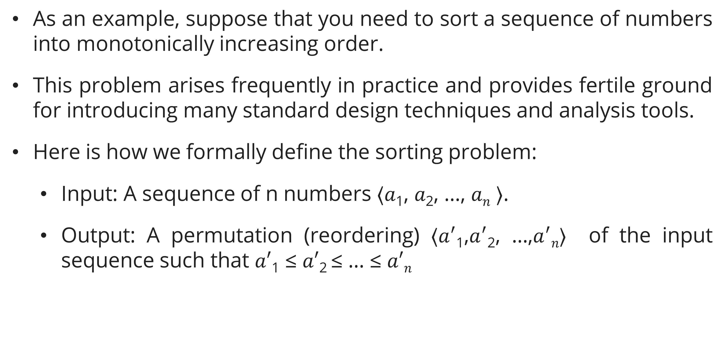
algorithms
sorting
As an example, suppose that you need to sort a sequence of numbers into monotonically increasing order.
This problem arises frequently in practice and provides fertile ground for introducing many standard design techniques and analysis tools.
Here is how we formally define the sorting problem:
  Input: A sequence of n numbers ⟨𝑎₁, 𝑎₂, …, 𝑎_{𝑛} ⟩.
  Output: A permutation (reordering) ⟨𝑎$′$₁,𝑎$′$₂, …,𝑎$′$_{𝑛}⟩ of the input sequence such that 𝑎$′$₁ ≤ 𝑎$′$₂ ≤ … ≤ 𝑎$′$_{𝑛}

Slide 12
algorithms
sorting
Thus, given the input sequence ⟨30, 20, 40, 10, 50⟩, a correct sorting algorithm returns as the output sequence ⟨10, 20, 30, 40, 50⟩.
Such an input sequence is called an instance of the sorting problem. In general, an instance of a problem consists of the input (satisfying whatever constraints are imposed in the problem statement) needed to compute a solution to the problem.

Slide 13
algorithms
sorting
Because many programs use it as an intermediate step, sorting is a fundamental operation in computer science.
As a result, you have a large number of good sorting algorithms at your disposal.
Which algorithm is best for a given application depends on:
  the number of items to be sorted,
  the extent to which the items are already somewhat sorted,
  possible restrictions on the item values,
  the architecture of the computer, and
  the kind of storage devices to be used: main memory, disks.

Slide 14
algorithms
Correct algorithm
An algorithm for a computational problem is correct if, for every problem in- stance provided as input, it halts (finishes its computing in finite time) and outputs the correct solution to the problem instance.
A correct algorithm solves the given computational problem.
An incorrect algorithm might not halt at all on some input instances, or it might halt with an incorrect answer.

Slide 15
algorithms
Problems solved by algorithms
The Human Genome Project has made great progress toward the goals of identifying all the roughly 30,000 genes in human DNA, determining the sequences of the roughly billion chemical base pairs that make up human DNA, storing this information in databases, and developing tools for data analysis. Each of these steps requires sophisticated algorithms. Dynamic programming is an important technique for solving several of these biological problems.
The internet enables people all around the world to quickly access and retrieve large amounts of information. With the aid of clever algorithms, sites on the internet are able to manage and manipulate this large volume of data. Examples of problems that make essential use of algorithms include finding good routes on which the data travels.

Slide 16
algorithms
Problems solved by algorithms
Manufacturing and other commercial enterprises often need to allocate scarce resources in the most beneficial way.
  An oil company might wish to know where to place its wells in order to maximize its expected profit.
  A political candidate might want to determine where to spend money buying campaign advertising in order to maximize the chances of winning an election.
  An airline might wish to assign crews to flights in the least expensive way possible, making sure that each flight is covered and that government regulations regarding crew scheduling are met.
  An internet service provider might wish to determine where to place additional resources in order to serve its customers more effectively.
All of these are examples of problems that can be solved by modeling them as linear programs.

Slide 17
algorithms
Problems solved by algorithms
Apart from the practical application of algorithms, there are also many techniques and the way to solve specific problems such as: Shortest path, file compression, topological sorting, etc.
These lists of the algorithmic problems are far from exhaustive, but they exhibit 2 characteristics common to many interesting algorithmic problems:
  They have many candidate solutions, the overwhelming majority of which do not solve the problem at hand. Finding one that does, or one that is “best” without explicitly examining each possible solution, can present quite a challenge.
  They have practical applications. Of the problems in the above list, finding the shortest path provides the easiest examples.
Notes:
A transportation firm, such as a trucking or railroad company, has a financial interest in finding shortest paths through a road or rail network because taking shorter paths results in lower labor and fuel costs. Or a routing node on the internet might need to find the shortest path through the network in order to route a message quickly. Or a person wishing to drive from New York to Boston might want to find driving directions using a navigation app.

Slide 18
algorithms
pseudocode
An algorithm can be specified in English, as a computer program, or even as a hardware design. The only requirement is that the specification must provide a precise description of the computational procedure to be followed.
Pseudocode is one of methods to write high-level specification of an algorithm.
It is usually written in combination of English and mathematic notations.
There are several components of pseudocode:
  Variable
  Iterative (loop): for-do, repeat-until, while-do
  Selection (branch): if-then, select-case
  Module: Procedure / Sub, Function, Recursive technique

Slide 19
Algorithms as a technology
Introduction
Computers may be fast, but they are not infinitely fast.
Computing time is therefore a bounded resource, which makes it precious.
Although the saying goes, “Time is money” time is even more valuable than money: you can get back money after you spend it, but once time is spent, you can never get it back.
Memory may be inexpensive, but it is neither infinite nor free. You should choose algorithms that use the resources of time and space efficiently.

Slide 20
Algorithms as a technology
efficiency
Different algorithms devised to solve the same problem often differ dramatically in their efficiency. These differences can be much more significant than differences due to hardware and software.
As an example, let’s use two algorithms for sorting (which you will learn later in session 3):
  Insertion sort: takes time roughly equal to 𝑐₁𝑛² to sort 𝑛 items, where to 𝑐₁ is a constant that does not depend on 𝑛.
  Merge sort: takes time takes time roughly equal to 𝑐₂𝑛 lg 𝑛 to sort 𝑛 items, where lg ⁡𝑛 stands for 𝑙𝑜𝑔₂ 𝑛 and 𝑐₂ is another constant that does not depend on 𝑛.
Insertion sort typically has a smaller constant factor than merge sort, so that 𝑐₁ < 𝑐₂.
We’ll see that the constant factors can have far less of an impact on the running time than the dependence on the input size.

Slide 21
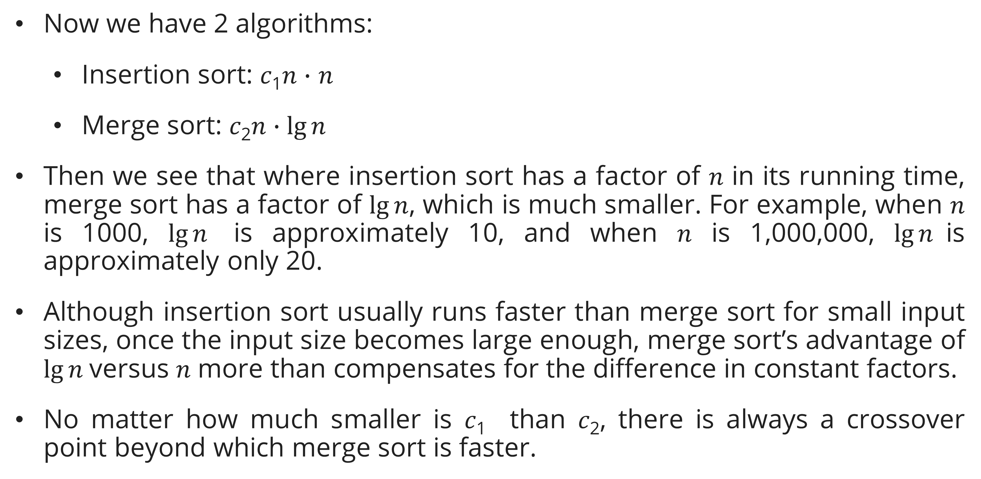
Algorithms as a technology
efficiency
Now we have 2 algorithms:
  Insertion sort: 𝑐₁𝑛 $∙$ 𝑛
  Merge sort: 𝑐₂𝑛 $∙\lg{n}$
Then we see that where insertion sort has a factor of 𝑛 in its running time, merge sort has a factor of $\lg{n}$, which is much smaller. For example, when 𝑛 is 1000, $\lg{n}$ is approximately 10, and when 𝑛 is 1,000,000, $\lg{n}$is approximately only 20.
Although insertion sort usually runs faster than merge sort for small input sizes, once the input size becomes large enough, merge sort’s advantage of $\lg{n}$versus 𝑛 more than compensates for the difference in constant factors.
No matter how much smaller is 𝑐₁ than 𝑐₂, there is always a crossover point beyond which merge sort is faster.

Slide 22
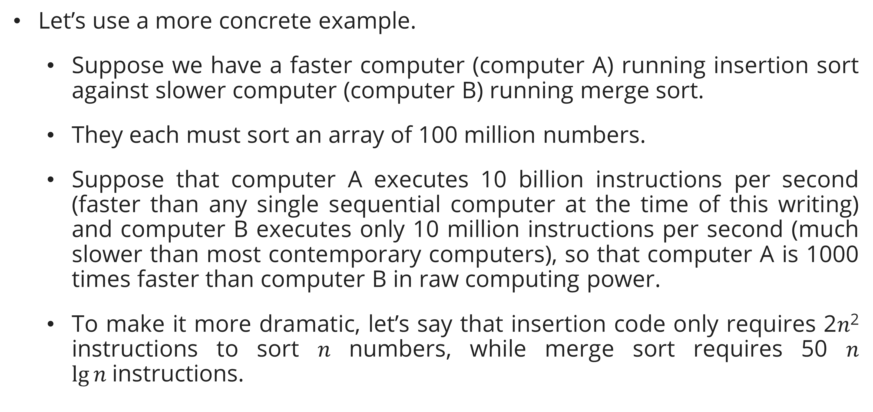
Algorithms as a technology
efficiency
Let’s use a more concrete example.
  Suppose we have a faster computer (computer A) running insertion sort against slower computer (computer B) running merge sort.
  They each must sort an array of 100 million numbers.
  Suppose that computer A executes 10 billion instructions per second (faster than any single sequential computer at the time of this writing) and computer B executes only 10 million instructions per second (much slower than most contemporary computers), so that computer A is 1000 times faster than computer B in raw computing power.
  To make it more dramatic, let’s say that insertion code only requires 2𝑛² instructions to sort 𝑛 numbers, while merge sort requires 50 𝑛 $\lg{n}$instructions.

Slide 23
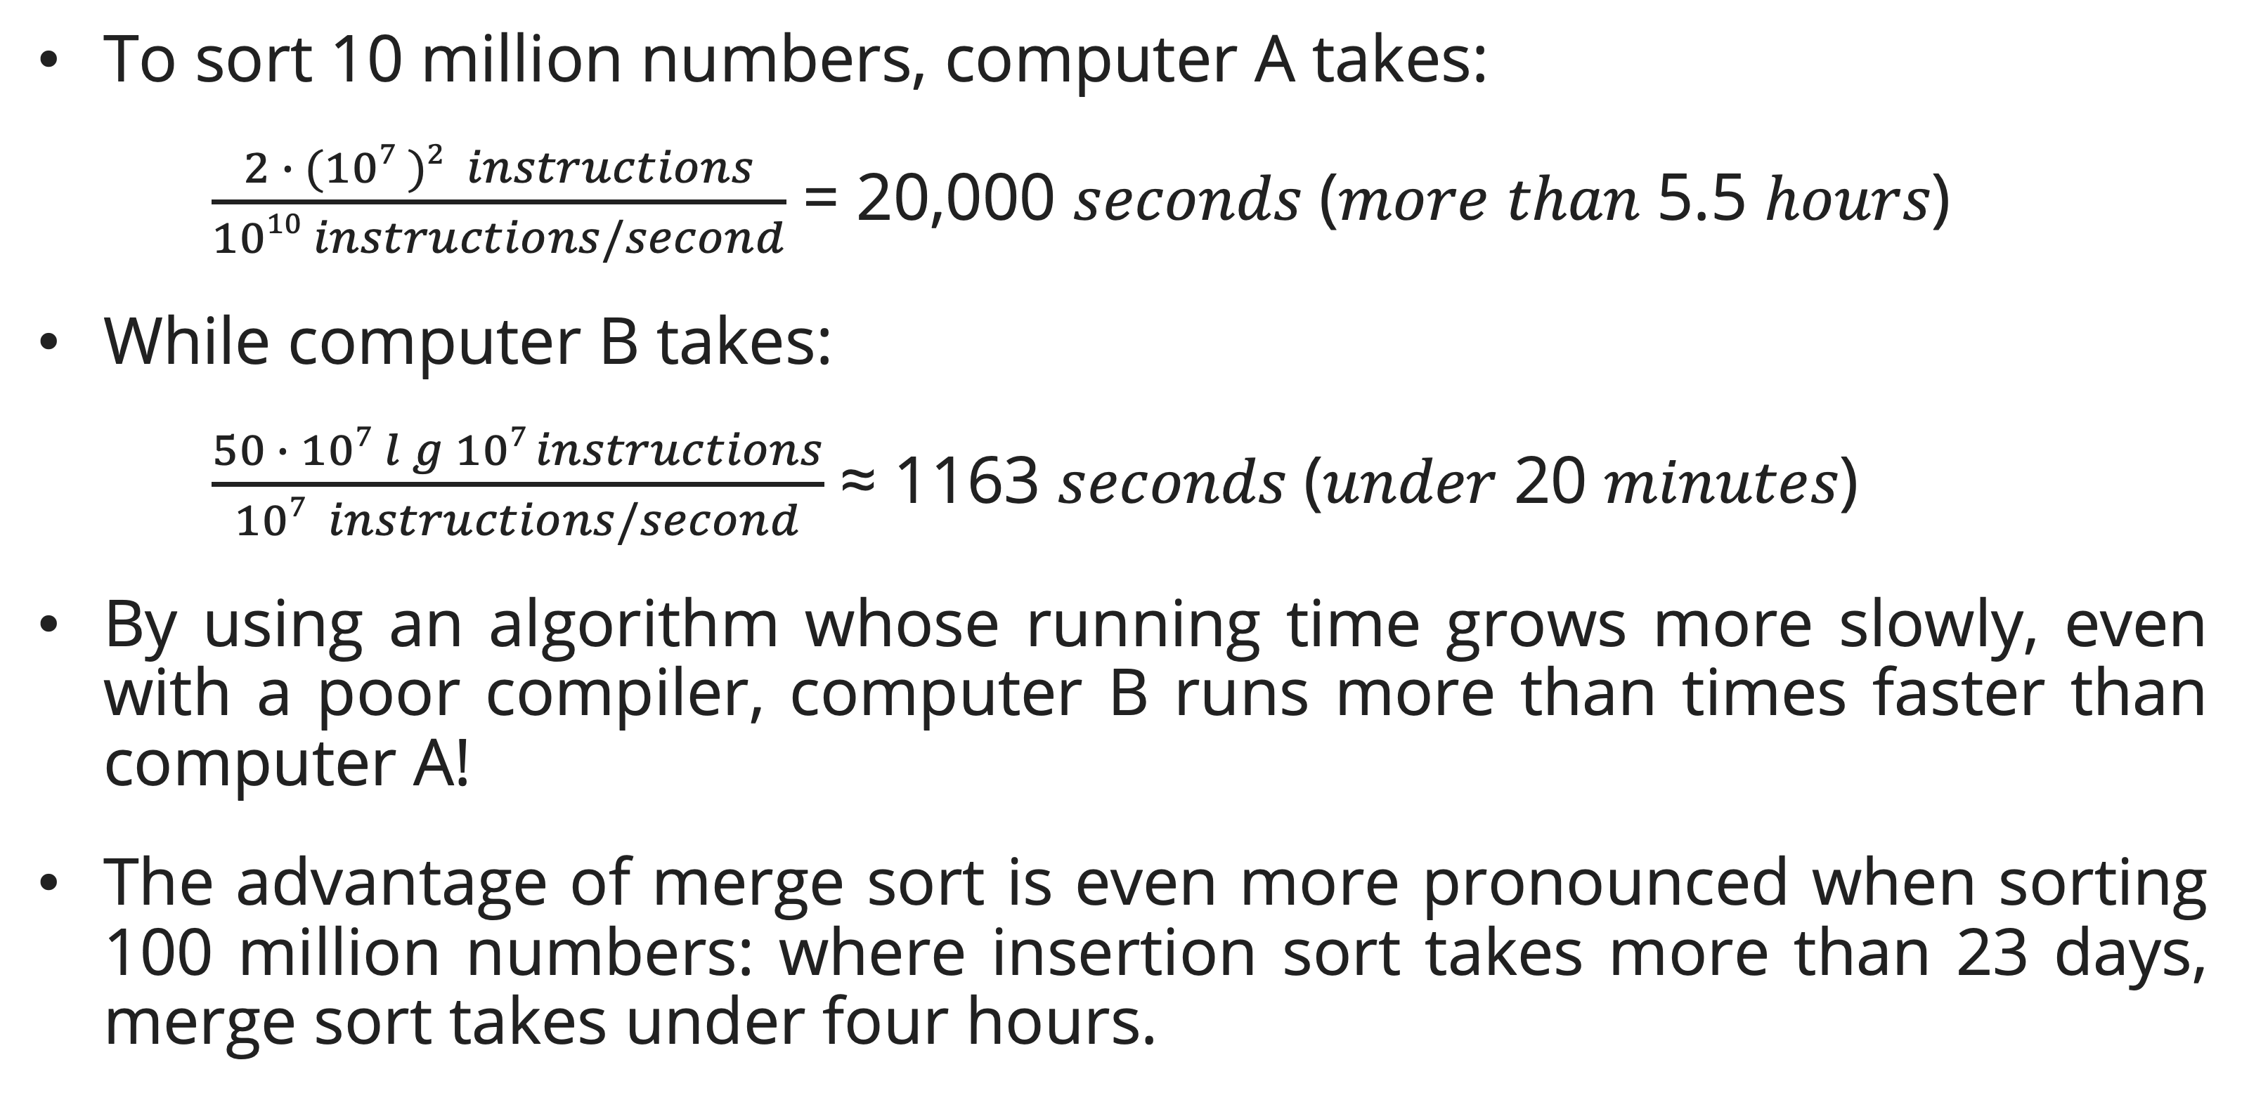
Algorithms as a technology
efficiency
To sort 10 million numbers, computer A takes:
    $\frac{2 ∙ (107 )2 instructions}{1010 instructions/second}$ = 20,000 𝑠𝑒𝑐𝑜𝑛𝑑𝑠 (𝑚𝑜𝑟𝑒 𝑡ℎ𝑎𝑛 5.5 ℎ𝑜𝑢𝑟𝑠)
While computer B takes:
    $\frac{50 ∙ 107 lg{107} instructions}{107 instructions/second}$ ≈ 1163 𝑠𝑒𝑐𝑜𝑛𝑑𝑠 (𝑢𝑛𝑑𝑒𝑟 20 𝑚𝑖𝑛𝑢𝑡𝑒𝑠)
By using an algorithm whose running time grows more slowly, even with a poor compiler, computer B runs more than times faster than computer A!
The advantage of merge sort is even more pronounced when sorting 100 million numbers: where insertion sort takes more than 23 days, merge sort takes under four hours.

Slide 24
Algorithms as a technology
Algorithms and other technology
The example from before shows that you should consider algorithms, like computer hardware, as a technology. Total system performance depends on choosing efficient algorithms as much as on choosing fast hardware.
Algorithms are still truly important on contemporary computers besides other advanced technologies, such as:
  advanced computer architectures and fabrication technologies,
  easy-to-use, intuitive, graphical user interfaces (GUIs),
  object-oriented systems,
  integrated web technologies,
  fast networking, both wired and wireless,
  machine learning,
  and mobile devices.

Slide 25
Algorithms as a technology
Algorithms and other technology
Even an application that does not require algorithmic content at the application level relies heavily upon algorithms. Why?
  The hardware design used algorithms
  The design of any GUI relies on algorithms.
  Routing in networks relies heavily on algorithms.
  Application written in language processed by a compiler, interpreter, or assembler, all of which make extensive use of algorithms.
Algorithms are at the core of most technologies used in contemporary computers.
With the ever-increasing capacities of computers, we use them to solve larger problems than ever before. As we saw in the above comparison between insertion sort and merge sort.

Slide 26
Algorithms as a technology
Algorithms and other technology
Having a solid base of algorithmic knowledge and technique is one characteristic that defines the truly skilled programmer.
With modern computing technology, you can accomplish some tasks without knowing much about algorithms, but with a good background in algorithms, you can do much, much more.

Slide 27
Practical Math Warm-up
Factorial
Definition: n! = n × (n−1) × (n−2) × … × 1, with 0! = 1.
Recursive formulation:
Iterative algorithm:
Complexity: T(n) = Θ(n) (exactly n−1 multiplications for n ≥ 1).
f(0) = 1
f(n) = n × f(n−1), n ≥ 1
FACTORIAL(n)
1 result = 1
2 for i = 2 to n
3 result = result × i
4 return result

Slide 28
Practical Math Warm-up
Factorial
Selected values:
Growth rate: Factorial grows faster than any polynomial or exponential. It appears in exhaustive-search algorithms such as brute-force TSP, which is why those approaches are infeasible for large n.
n | n!
0 | 1
5 | 120
10 | 3,628,800
20 | 2,432,902,008,176,640,000
25 | ≈ 1.55 × 10²⁵

Slide 29
Practical Math Warm-up
Fibonacci Numbers
Definition: F(0) = 0, F(1) = 1, F(n) = F(n−1) + F(n−2) for n ≥ 2.
First 12 values: 0, 1, 1, 2, 3, 5, 8, 13, 21, 34, 55, 89.
Naïve recursive implementation:
Time complexity: Θ(φⁿ) where φ = (1+√5)/2 ≈ 1.618 — exponential. The recurrence tree has overlapping sub-problems: F(n−2) is computed once by the left branch and again by the right branch.
FIB-NAIVE(n)
1 if n ≤ 1
2 return n
3 return FIB-NAIVE(n−1) + FIB-NAIVE(n−2)

Slide 30
Practical Math Warm-up
Fibonacci Numbers
Efficient iterative (bottom-up DP):
Time: Θ(n), Space: Θ(1).
Fibonacci is the canonical motivating example for Dynamic Programming, as the exponential naïve solution collapses to linear once overlapping sub-problems are identified and cached (covered fully in Session 15).
FIB-ITER(n)
1 if n ≤ 1: return n
2 prev = 0, curr = 1
3 for i = 2 to n
4 next = prev + curr
5 prev = curr
6 curr = next
7 return curr

Slide 31
Practical Math Warm-up
Primality Testing
Definitions:
A prime p > 1 has exactly two divisors: 1 and p.
A composite n > 1 has a factor d with 1 < d < n.
Trial division — naïve:
Complexity: O(n).
IS-PRIME-NAIVE(n)
1 for d = 2 to n−1
2 if n mod d == 0: return false
3 return true

Slide 32
Practical Math Warm-up
Primality Testing
Improved — trial division up to √n:
Key insight: if n has a divisor d > √n, then n/d < √n is also a divisor (and has already been tested).
Complexity: O(√n).
Primality testing has applications in cryptography (RSA key generation requires large primes). Efficient probabilistic tests (Miller–Rabin) exist for very large primes.
IS-PRIME(n)
1 if n < 2: return false
2 if n == 2: return true
3 if n mod 2 == 0: return false
4 d = 3
5 while d × d ≤ n
6 if n mod d == 0: return false
7 d = d + 2
8 return true

Slide 33
Practical Math Warm-up
Sieve of Eratosthenes
Goal: Find all primes up to n.
Algorithm:
Why start marking at p²? All smaller multiples of p (i.e., 2p, 3p, …, (p−1)p) have already been marked as composite by earlier primes less than p.
SIEVE(n)
1 Create boolean array sieve[2..n], all set to true
2 for p = 2 to floor(√n)
3 if sieve[p] == true
4 for k = p² to n step p
5 sieve[k] = false
6 return all i where sieve[i] == true

Slide 34
Practical Math Warm-up
Sieve of Eratosthenes
Complexity:
Time: O(n log log n) — nearly linear (the harmonic series of reciprocals of primes converges to O(log log n)).
Space: O(n).
Example for n = 30: Primes found: 2, 3, 5, 7, 11, 13, 17, 19, 23, 29.
SIEVE(n)
1 Create boolean array sieve[2..n], all set to true
2 for p = 2 to floor(√n)
3 if sieve[p] == true
4 for k = p² to n step p
5 sieve[k] = false
6 return all i where sieve[i] == true
The Sieve illustrates how pre-computation and smart elimination can collapse what looks like an O(n√n) problem into a near-linear one — a preview of the power of algorithmic thinking.

Slide 35
Intuitive Order of Growth
Common Growth Functions
As n grows, the dominant term of a running-time function determines practical performance. Listed slowest to fastest:
Class | Name | Example
O(1) | Constant | Array access A[i]
O(log n) | Logarithmic | Binary search
O(n) | Linear | Sequential scan
O(n log n) | Linearithmic | Merge sort, Heapsort
O(n²) | Quadratic | Insertion sort (worst)
O(n³) | Cubic | Naïve matrix multiply
O(2ⁿ) | Exponential | Brute-force subset enumeration
O(n!) | Factorial | Brute-force TSP

Slide 36
Intuitive Order of Growth
Why Order of Growth Matters
Approximate operation counts for n = 1,000,000 (10⁶):
Practical rule: prefer algorithms with lower-order growth for large inputs. Constant factors matter for small inputs; growth rate dominates for large inputs.
We will make this intuition precise with asymptotic notation (O, Ω, Θ) in Session 04.
T(n) | Operations | At 10⁹ ops/sec
log₂ n | ~20 | < 1 microsecond
n | 10⁶ | ~1 millisecond
n log n | ~2 × 10⁷ | ~20 milliseconds
n² | 10¹² | ~17 minutes
n³ | 10¹⁸ | ~32 years
2ⁿ | 10³⁰⁰⁰⁰⁰ | longer than the universe's age

Slide 37
Problem Modeling
Why Modeling Matters
Most real-world problems are stated informally. Before applying an algorithm, we must model the problem by expressing it in terms of a clean, formal computational problem. Good modeling connects the messy real world to the precise algorithmic world.

Slide 38
Problem Modeling
Steps in Problem Modeling
Identify the input objects: points, numbers, strings, edges, sets?
Define what "correct" means: minimum? maximum? any valid solution? all solutions?
Recognize the problem type: sorting? graph traversal? optimization? search?
Map to a known algorithm: BFS, DP, greedy, backtracking, approximation?

Slide 39
Problem Modeling
Common Combinatorial Object Models (Skiena, Ch. 1.5)
Object | Typical Problem Types
Permutations | Scheduling, arrangement, assignment, TSP
Subsets | Knapsack, vertex cover, set cover
Trees | MST, parse tree, decision tree
Graphs | Shortest path, network flow, bipartite matching
Points | Closest pair, convex hull, clustering
Strings | Pattern matching, edit distance, DNA alignment

Slide 40
Problem Modeling
Case Study: Robot Tour Optimization (Skiena, Ch. 1.1)
Problem statement: A robot arm must solder n contact points on a circuit board. Find the order to visit all points that minimizes total travel distance.
Naïve approach: try all n! orderings and pick the shortest.
For n = 20: 20! ≈ 2.4 × 10¹⁸ — completely infeasible even at 10⁹ ops/sec (takes ~77 billion years).
Incorrect greedy heuristic (Nearest Neighbor): Always move to the nearest unvisited point. Intuitive, fast (O(n²)), but does not always give the optimal tour.

Slide 41
Problem Modeling
Case Study: Robot Tour Optimization (Skiena, Ch. 1.1)
Counterexample (Skiena, Ch. 1.1, p. 3–5): Consider 4 contact points arranged in a diamond (rhombus) shape:
Edge lengths: A-B = B-C = C-D = D-A = √5 ≈ 2.24 (all perimeter edges equal). Diagonal: B-D = 2 (shorter than any perimeter edge).
NN tour starting at A: A→B (√5 ≈ 2.24), then nearest unvisited from B is D (dist=2, shorter than C at √5) → B→D (2), then D→C (√5 ≈ 2.24), then return C→A (4).
NN total = √5 + 2 + √5 + 4 = 6 + 2√5 ≈ 10.47
Optimal tour (perimeter sweep): A→B→C→D→A = √5 + √5 + √5 + √5 = 4√5 ≈ 8.94
B = (2, 1)
/ \
A C A=(0,0), B=(2,1), C=(4,0), D=(2,−1)
\ /
D = (2,−1)

Slide 42
Problem Modeling
Case Study: Robot Tour Optimization (Skiena, Ch. 1.1)
Why NN fails: It greedily chooses the short diagonal B→D (length 2) rather than the perimeter edge B→C (length √5 ≈ 2.24). This saves 0.24 now but forces the expensive closing edge C→A=4, while the perimeter tour closes cheaply with D→A=√5. The locally greedy choice leaves the algorithm "stranded" far from the start.
On adversarial inputs with n points arranged so that NN repeatedly takes cheap shortcuts into the interior, the NN tour can be approximately 2× the optimal length (Skiena, Ch. 1.1).
Correct model: This is the Traveling Salesman Problem (TSP) — (NP-hard, Session 23–24). No known polynomial-time exact algorithm exists. Practical approaches use approximation algorithms.
Lesson: The first algorithmic idea is often wrong. Model the problem correctly before choosing an algorithm.

Slide 43
Problem Modeling
Case Study: Psychic Modeling (Skiena, Ch. 1.8)
Skiena's "War Story" describes a scheduling problem that initially appeared to require a complex algorithm. Once correctly modeled, it reduced to a simple sorting problem solvable in O(n log n). The story illustrates that correct modeling often reveals a simpler algorithm than initially imagined.

Slide 44
Summary
Session 1
An algorithm is a sequence of computational steps that transform the input into the output.
There are many problems solved by algorithms such as human genome, the internet, manufacturing, etc.
Algorithm is a technology because total system performance depends on choosing efficient algorithms as much as on choosing fast hardware.
Having a solid base of algorithmic knowledge and technique is one characteristic that defines the truly skilled programmer.

Slide 45
Exercises
Session 1
Suppose that for inputs of size 𝑛 on a particular computer, insertion sort runs in 8𝑛² steps and merge sort runs in 64 𝑛 lg⁡𝑛 steps. For which values of 𝑛 does insertion sort beat merge sort?
What is the smallest value of 𝑛 such that an algorithm whose running time is 100𝑛² runs faster than an algorithm whose running time is 2^{𝑛} on the same machine?

Slide 46
References
Session 1
Primary (Required): Cormen, T.H., Leiserson, C.E., Rivest, R.L., & Stein, C. (2022). Introduction to Algorithms, 4th Edition. MIT Press.
Ch. 1.1 — Algorithms (p. 5)
Ch. 1.2 — Algorithms as a Technology (p. 12)
Secondary (Required): Skiena, S.S. (2020). The Algorithm Design Manual, 3rd Edition. Springer.
Ch. 1.1 — Robot Tour Optimization
Ch. 1.5 — Modeling the Problem
Ch. 1.8 — War Story: Psychic Modeling
Reference: Sridhar, S. (2015). Design and Analysis of Algorithms. Oxford University Press. Chapter 1.

